Slide 1

Technical report

Slide 2
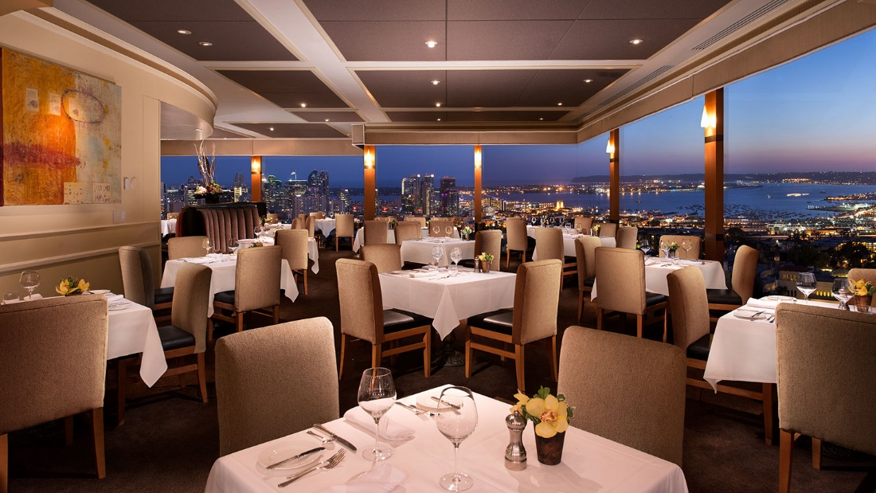
Abstract
There are numerous ventures of growth on the restaurant business
The restaurant business has many unprecedented and acknowledged challenges that management has to overcome.
The management faces challenges such as capital investment, organizational culture formulation, and compensation.

Slide 3
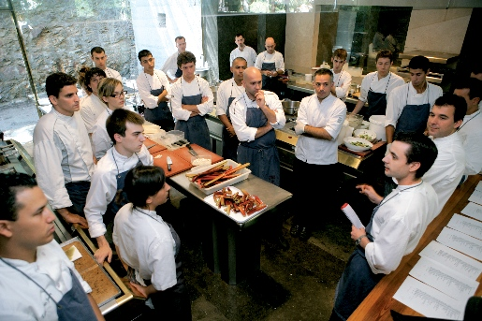
Chapter 1; Introduction
This project was a success attributed to the best practices employed by the management.
This study was able to notice the hiccups and various milestones experienced by the industry in the United States market and in the lives of many it affects.

Slide 4
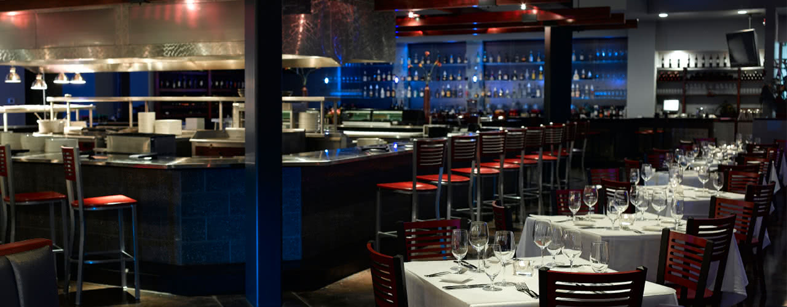
Chapter 2; Research review of the literature
In the business of the restaurant, there are any unprecedented and acknowledged challenges that develop during operation.
Capital Investment; There needs to be capital for operation and also for increasing the businesses investment.
Business expansion; The prospects of the company that has been able to successfully build can be established through restaurant expansion and international market entry to increase the revenue streams.

Slide 5

Chapter 3; Research methodology
This was unstructured research where there was not much emphasis on a structured format
Interviews with willing customers were conducted.
The data were then analyzed regarding percentages and used after that.

Slide 6

Chapter 4; Research findings
Organization culture; 95% of restaurateurs agree that restaurant organization culture increases the productivity of the employees and thereby its profitability
Compensation; 36% of employers cite this as a major challenge in finding staff that will work competently with the restaurant.
Restaurant location; 63% of the respondents agreed that strategic location of business increases its performance, attracts business investors and enables expansion

Slide 7

Chapter 5; Conclusion
The restaurant business is a likely business that would change the stake in the market offering high employment rates.
Stakeholders are required to introspect deeply into the various setbacks, make changes to those they feel impact them and then work towards excellence.

Slide 8
Reference
Giousmpasoglou, C. (2016). Hotel and restaurant management education.
O’Neill, J. W., & Mattila, A. S. (2006). Strategic hotel development and positioning: The effects of revenue drivers on profitability. Cornell Hotel and Restaurant Administration Quarterly, 47(2), 146-154.
Upneja, A., & Dalbor, M. C. (2001). An examination of capital structure in the restaurant industry. International Journal of Contemporary Hospitality Management, 13(2), 54-59.
Zheng, C., & Forgacs, G. (2017). The emerging trend of hotel total revenue management. Journal of Revenue and Pricing Management

